Slide 1
Analyzing your source code using Android Lint
By:- Rahul Malhotra

Slide 2
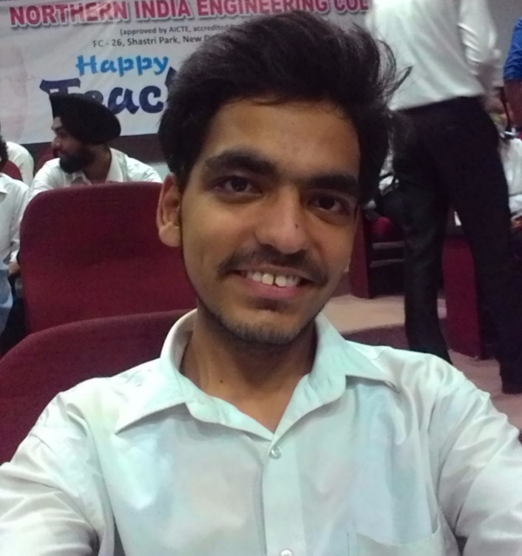
About Me
Currently working as a Software Engineer at SaaSfocus
Working as an Independent Salesforce Consultant
Worked as a Full Stack Developer Earlier

Slide 3
Today’s Agenda
Why do we need a Good Code ?
Features of Good Code
Importance of Source Code Analysis
Introduction to Android Lint
Hands on demonstration of Source Code Analysis using Android Lint
Other source code analyzers

Slide 4
Why do we need a good code ?
Software development takes a lot of time and effort
As an individual part-time contributor, I cannot complete a big project on my own
Bad or Messy code is hard to read and understand and other programmers may lose interest while reading your code
Source code is a means of communication between a programmer and an application so that the programmer can understand which role is played by which part of code

Slide 5
Features of Good Code
Cleanliness – Easier to read
Consistency – Easier to understand
Extensibility – Easier to Reuse
Correctness – Lesser bugs

Slide 6
Importance of Source Code Analysis
Developers always have a point of view to build the application
They want to build and deliver new features as soon as possible
They don’t like to analyze the source code by themselves
Source code analysis should be automated

Slide 7
Introduction to Android Lint
Android Lint is an inbuilt linter from android
It is used to analyze our code and make sure that it is properly structured
Improperly Structured Code effect the readability and understanding of code
It is used to automate the code analysis process and takes care that you always write quality code

Slide 8

Demo Time

Slide 9
Other Source Code Analyzers
PMD :– PMD (Programming Mistake Detector) is an extensible cross-language static code analyzer.
Finds unused variables, empty catch blocks, unnecessary object creation etc.
Includes CPD, the copy-paste-detector. CPD finds duplicated code.
Support Multiple Languages

Slide 10

Q & A

Slide 11
Thank You
Reach me on Twitter:- @rahulcoder
GitHub:- https://www.github.com/rahulmalhotra
About Me:- http://bit.ly/rahulabout
Blogger and YouTuber at :- SFDC Stop (https://sfdcstop.blogspot.com)

